Slide 1
Unity Basics Physics and Collisions in Unity

Slide 2
Recap

Slide 3
Table of contents
01
Physics in Games
04
Rigidbody and Gravity
02
Vectors and 3D Maths
05
Jumping Mechanic
03
Physics Components
06
Collision Detection
Realism
Interactivity
Gameplay variety
Physics based movement controller
Physics Material
What are Vectors?
Unity Vector3 & Vector2
Vector Operations
Physics jump mechanic
Rigidbody
Collider
Physics Material
Detecting Collisions

Slide 4
01
Physics In Games
The Importance of Physics In Games

Slide 5
What is the importance of physics in games?
Realism
Interactivity
Gameplay Variety

Slide 6
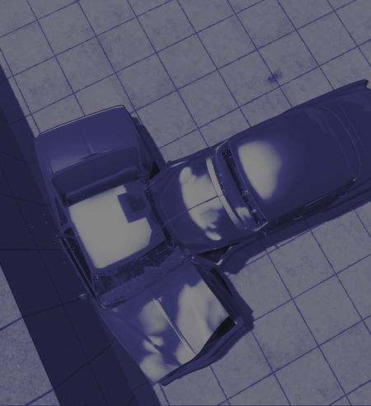
Realism
Immersion: Realistic physics can make the game world feel more authentic and believable.
Problem-solving: Players can use their understanding of real-world physics to solve in-game challenges and puzzles.
Strategy: Realistic physics can affect gameplay strategies, as players need to consider the physical properties of objects when making decisions.

Slide 7
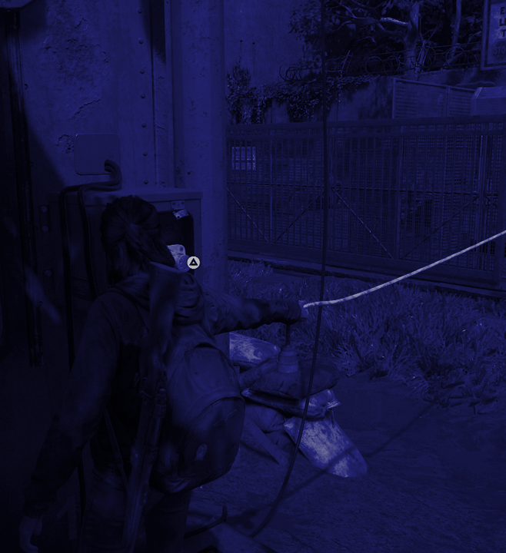
Interaction
Engagement: Physics-based interactions can create engaging and dynamic gameplay experiences by allowing players to experiment and manipulate the game world.
Player agency: Physics interactions provide players with a sense of control, enabling them to influence the game environment and outcomes.
Emergent gameplay: Physics-driven interactions can lead to unexpected and emergent gameplay scenarios, making each playthrough unique.
Creativity: Players can use the game's physics to be creative, devising unique solutions to challenges and puzzles.

Slide 8
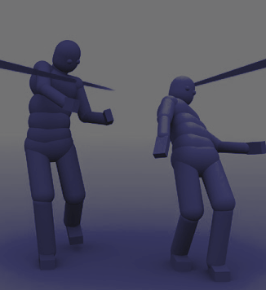
Variety
Variety: can introduce diversity, preventing the game from becoming repetitive and keeping players engaged.
Replayability: Games with a variety of physics-based challenges encourage replayability as players seek to master different mechanics and approaches.
Innovation: Creative use of physics can lead to innovative and memorable gameplay moments that set a game apart from others in the genre.

Slide 9
Examples of Physics in Games

Slide 10
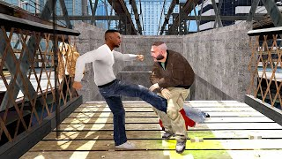
GTA IV - Euphoria Physics:
Realism: In GTA IV, the Euphoria physics engine creates realistic character animations and reactions to various in-game events, such as characters stumbling realistically when shot or reacting dynamically to collisions.
Interaction: Players can see how the physics engine affects character movement and behavior, making the game's world feel alive and unpredictable.
Gameplay Variety: Euphoria physics enable diverse and unpredictable combat scenarios, adding variety to the gameplay as players can never be sure how characters will react in different situations.

Slide 11
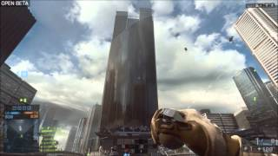
Battlefield 4 (CryEngine):
Realism: CryEngine in Battlefield 4 provides realistic environmental destruction. Buildings and terrain can be destroyed dynamically, impacting gameplay by altering cover and creating new strategic possibilities.
Interaction: Players can interact with the environment in ways that affect the battlefield. For example, players can destroy walls to create new paths or collapse structures on enemies.
Gameplay Variety: The dynamic destruction in Battlefield 4 introduces a high level of variety in multiplayer matches, as each round can play out differently due to the changing environment.

Slide 12
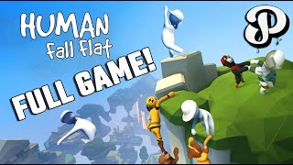
Human: Fall Flat:
Realism: While the game doesn't aim for realism in the traditional sense, it uses physics to create a comically clumsy and floppy character. The physics engine makes the character's movements and interactions intentionally unrealistic for humorous effect.
Interaction: Physics-based puzzles and platforming mechanics are central to the gameplay. Players manipulate objects and the character's body to solve challenges.
Gameplay Variety: The game's physics-driven puzzles and interactions ensure that each level presents a unique set of challenges, promoting creativity and experimentation.

Slide 13
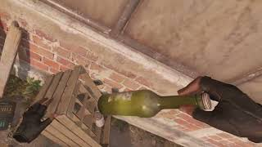
Half-Life: Alyx:
Realism: The Source 2 engine in Half-Life: Alyx provides realistic physics interactions. Players can pick up and manipulate objects in a lifelike manner, creating a strong sense of presence in the virtual world.
Interaction: Players rely on physics-based interactions to solve puzzles and engage in combat. Accurate object manipulation is essential for progress.
Gameplay Variety: The game's physics-based interactions introduce a new dimension to gameplay, forcing players to think about how to use objects in the environment strategically. This adds depth and variety to the VR experience.

Slide 14
02
Vectors & 3D Maths
Vectors in Unity

Slide 15
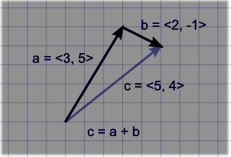
Vectors in Unity
Vectors are mathematical objects used to represent quantities with both magnitude and direction. In Unity, they are fundamental for describing positions, directions, and forces.

Slide 16

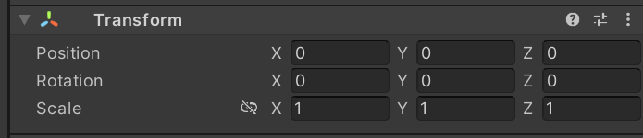

What are Vectors?
Vectors are used for Transform components
This is made of a vector for Position, Rotation and Scale
Vectors are represented by the struct Vector3
2D objects can be represented with Vector2

Slide 17
Vector Operations (1)
Addition: Used calculate a direction
Subtraction: The difference between two points or the direction between
Multiplication: Used for scale or to apply a speed

Slide 18
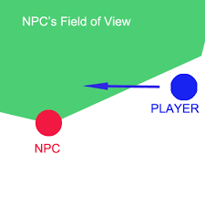
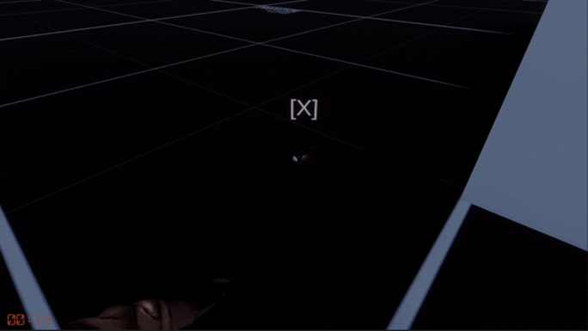
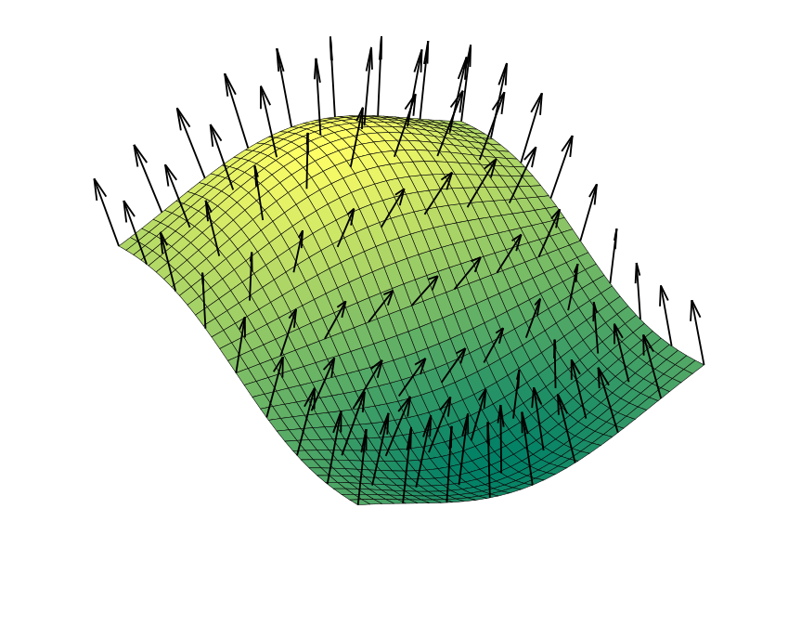
Vector Operations (2)
Dot Product: Used for calculating normals or generating vectors at right angle
Cross Product: Calculates a perpendicular vector to two other vectors

Slide 19
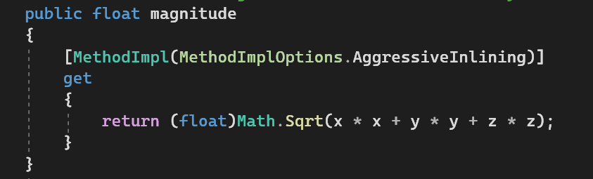

Vector Operations (3)
Magnitude: Size or Length of the vector. This gives you the speed if applied to a velocity vector.
This is an expensive operation. Use SqrMagnitude if you are doing this in Update()

Slide 20
03
Physics Components
Rigidbody, Colliders and Physics Materials

Slide 21



Physics Components
Rigidbody
Collider
Physics Materials

Slide 22
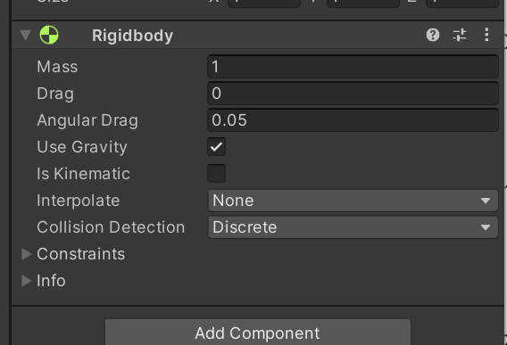
Rigidbody
Physics Simulation: enables game objects to interact with the physics engine, allowing them to respond to forces like gravity, collisions, and forces applied by scripts.
Collision Handling: It ensures that the GameObject does not pass through other non-trigger colliders and that the collisions can be registered
Force: You can apply force or torque to Rigidbodies allowing for physics based movements or behaviours.

Slide 23

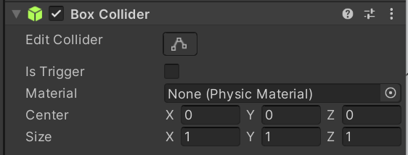
Collider
Invisible simplified shapes that approximate the boundaries of an object for the physics engine
Can be either solid (Rigidbodies will collide) or Triggers (Rigidbodies will pass through but will send collision events)
The shape can be changed to use a primitive shape or a mesh collider.
Collisions can be filtered in layers allowing control over what collides and what doesn’t

Slide 24

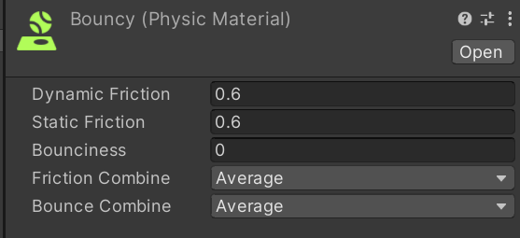
Physics Material
Not a component but rather an asset applied to a collider.
Allows for the adjustment of properties such as friction and bounciness
Useful for adding variety to surfaces the player can walk on or adjusting the behaviour of physics objects.

Slide 25
04
Collision
Detecting Collision

Slide 26
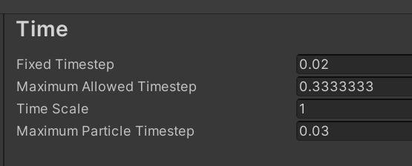
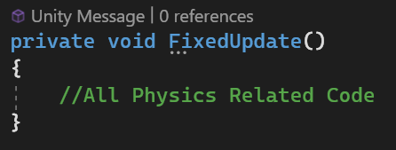
Collision Detection (1)
In order for collisions to be registered the two GameObjects must have colliders and at least one must have a rigidbody component.
Unity Physics works in a separate thread and is calculated on a fixed timestep irrespective of frame rate.
For this reason, We should not apply or read physics values in Update()

Slide 27
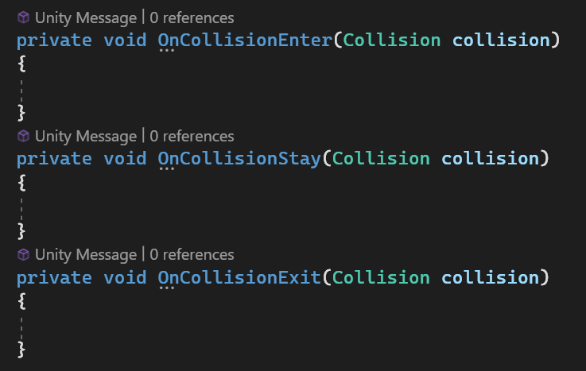
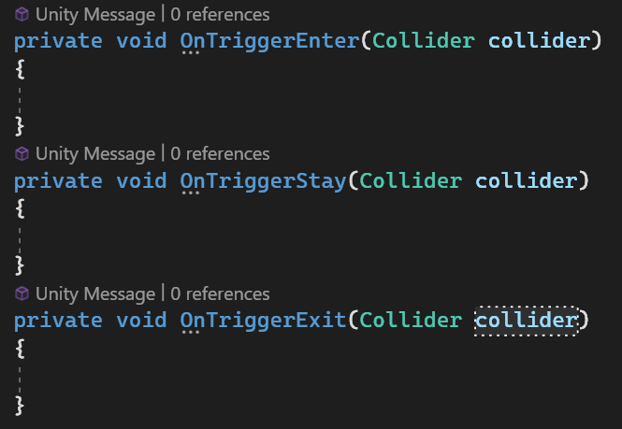
Collision Detection (2)
Unity has built in functions for reading collision data as they happen.

Slide 28
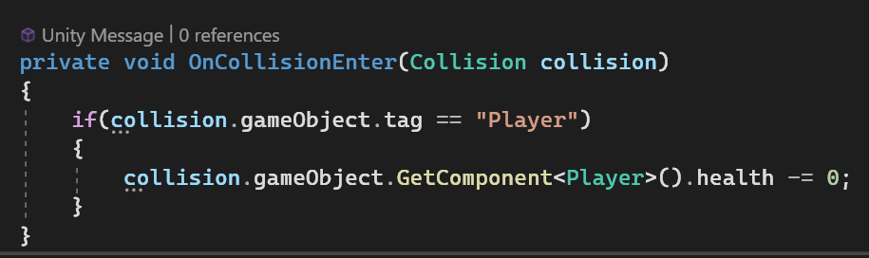
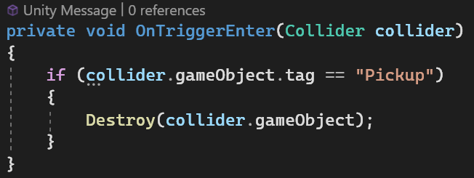
Collision Detection (3)
Notice the parameters
OnCollision, gives you information about the Collision including impulse and contact points.
OnTrigger, no collision occurs. The function passes through the collider of the other GameObject.

Slide 29
Short Break

Slide 30
Thanks!

